Slide 1
Сучасні техніки застосування технологій машинного навчання до обробки текстів

Slide 2
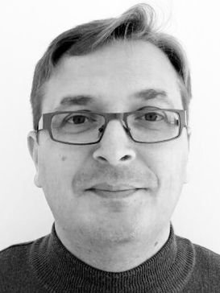
Денис Ступак
Data Scientist, EPAM Ukraine
16 лет преподавательской деятельности в ВУЗах;
5 лет в IT;
3 года на позиции Data Scientist в SPD-Group Ukraine;
2 года Senior Data Analyst в EPAM Ukraine
3 сезона - преподаватель на GeekHub на курсе Data Science
3 года - преподаватель на курсах Intro Python, ML в IT школе Hillel

Slide 3
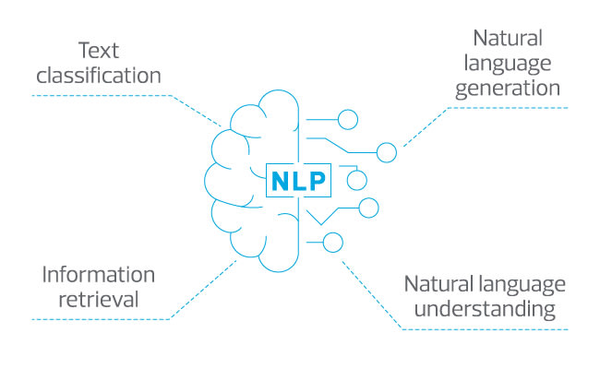

Slide 4
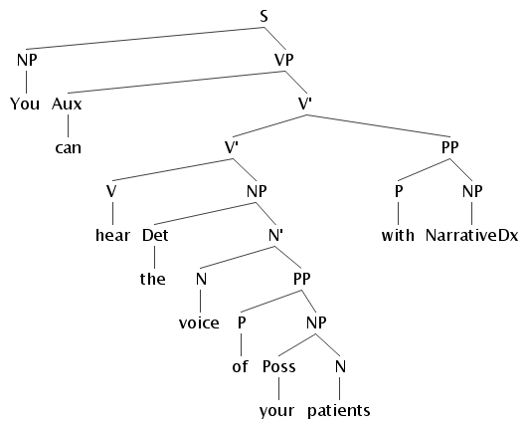

Slide 5
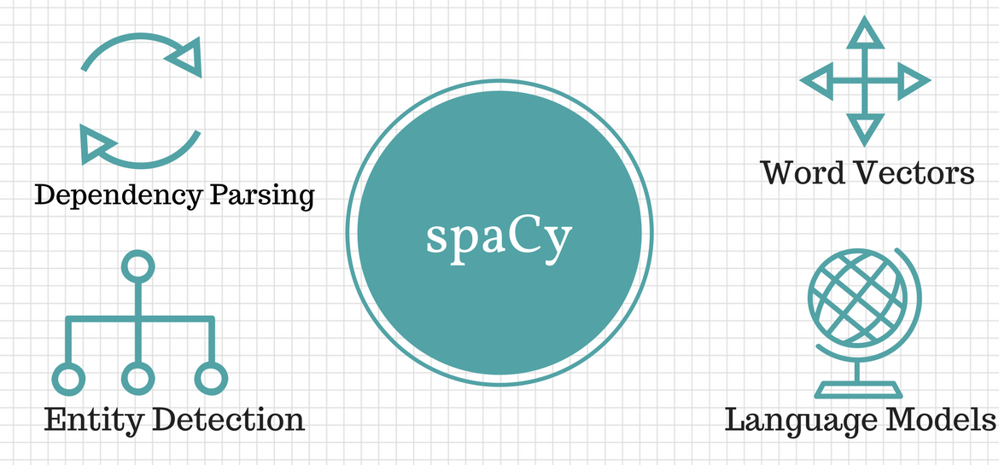

Slide 6
1 2 3 4 5 6 7 8 9 10 11 12 13 14 15 16 17 18 19 20 21 22 | doc = nlp("Next week I'll be in Madrid.") for token in doc: print("{0}\t{1}\t{2}\t{3}\t{4}\t{5}\t{6}\t{7}".format( token.text, token.idx, token.lemma_, token.is_punct, token.is_space, token.shape_, token.pos_, token.tag_ )) # Next 0 next False False Xxxx ADJ JJ # week 5 week False False xxxx NOUN NN # I 10 -PRON- False False X PRON PRP # 'll 11 will False False 'xx VERB MD # 15 False True SPACE _SP # be 17 be False False xx VERB VB # in 20 in False False xx ADP IN # Madrid 23 madrid False False Xxxxx PROPN NNP # . 29 . True False . PUNCT .

Slide 7
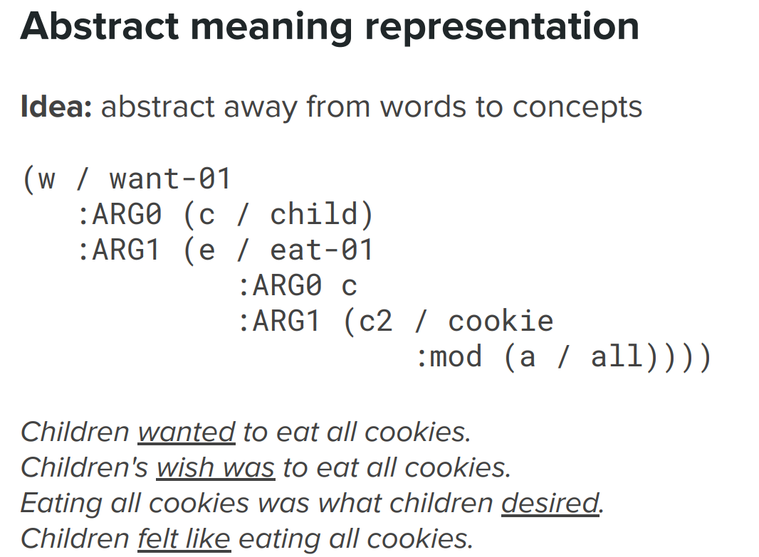
https://hanlp.hankcs.com/en/demos/amr.html

Slide 8
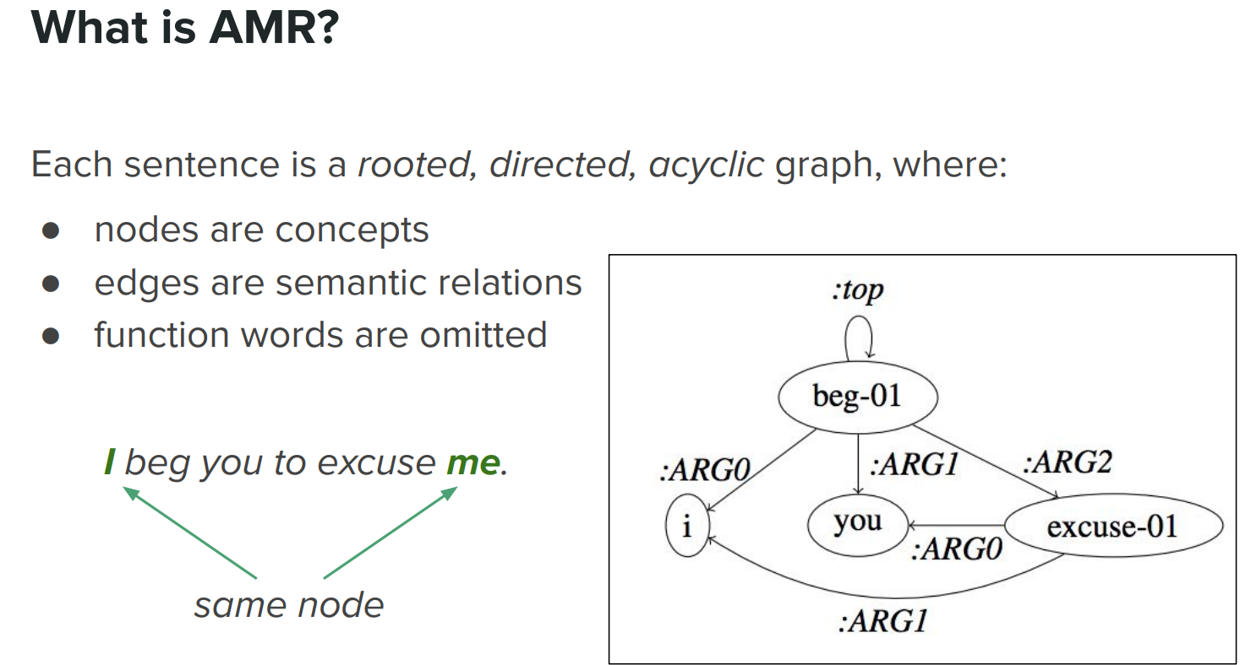

Slide 9
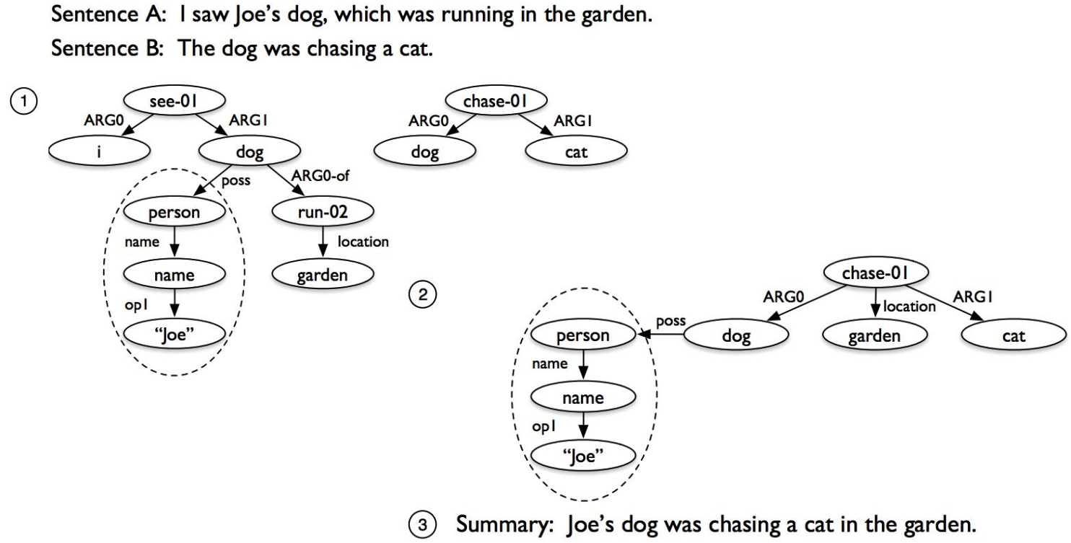

Slide 10
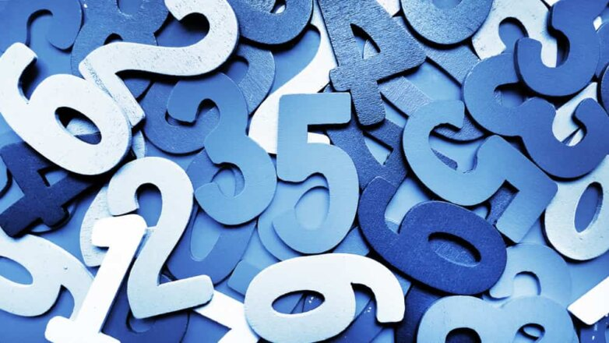

Slide 11
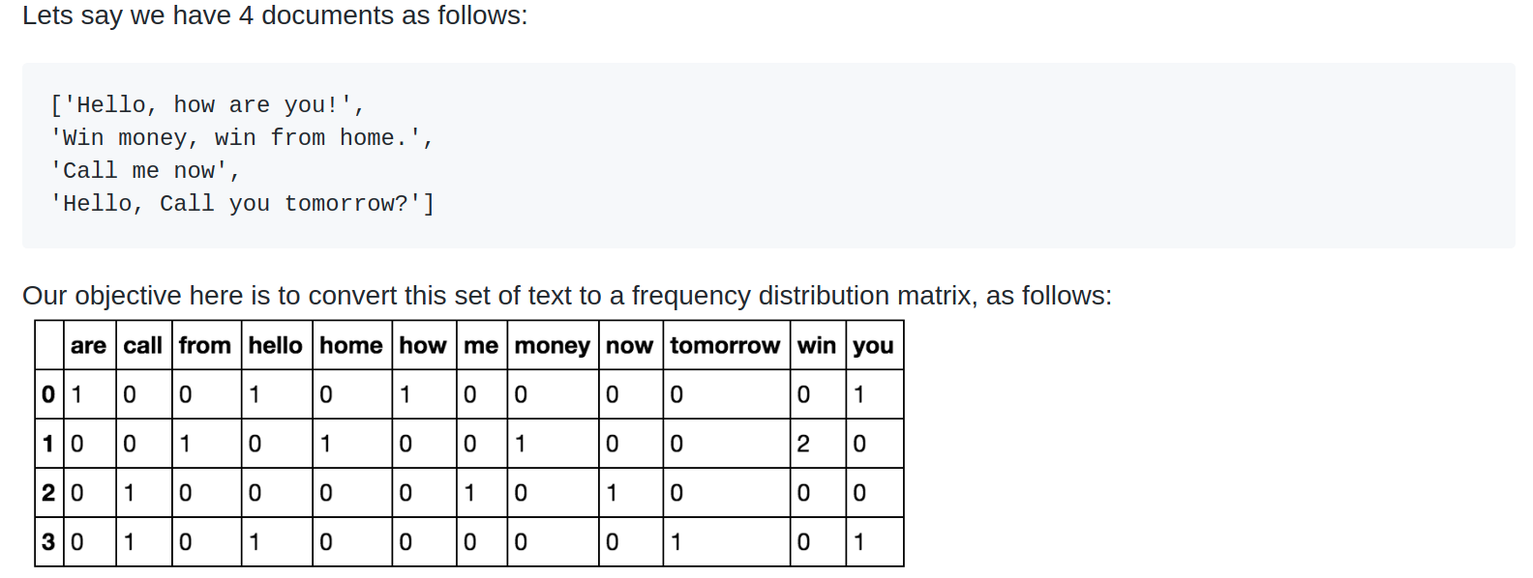
Bag of words

Slide 12
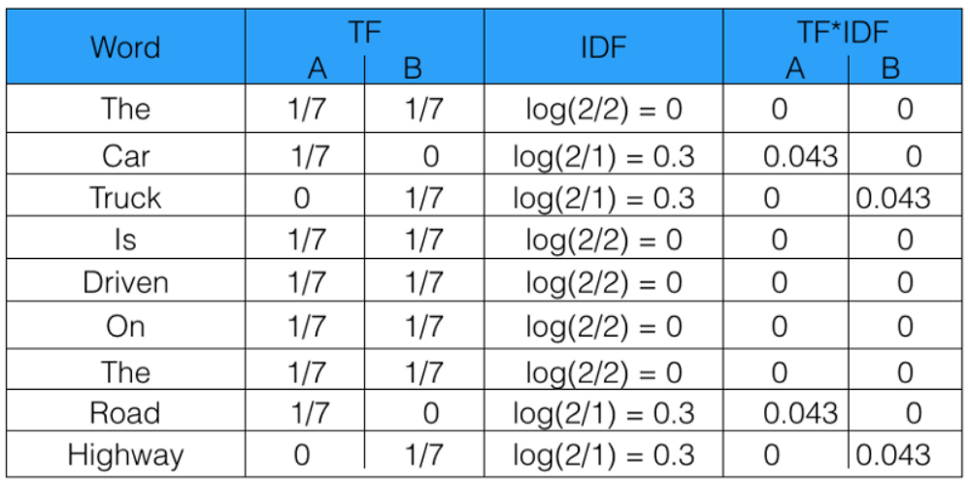
TF-IDF (TF — term frequency, IDF — inverse document frequency)

Slide 13
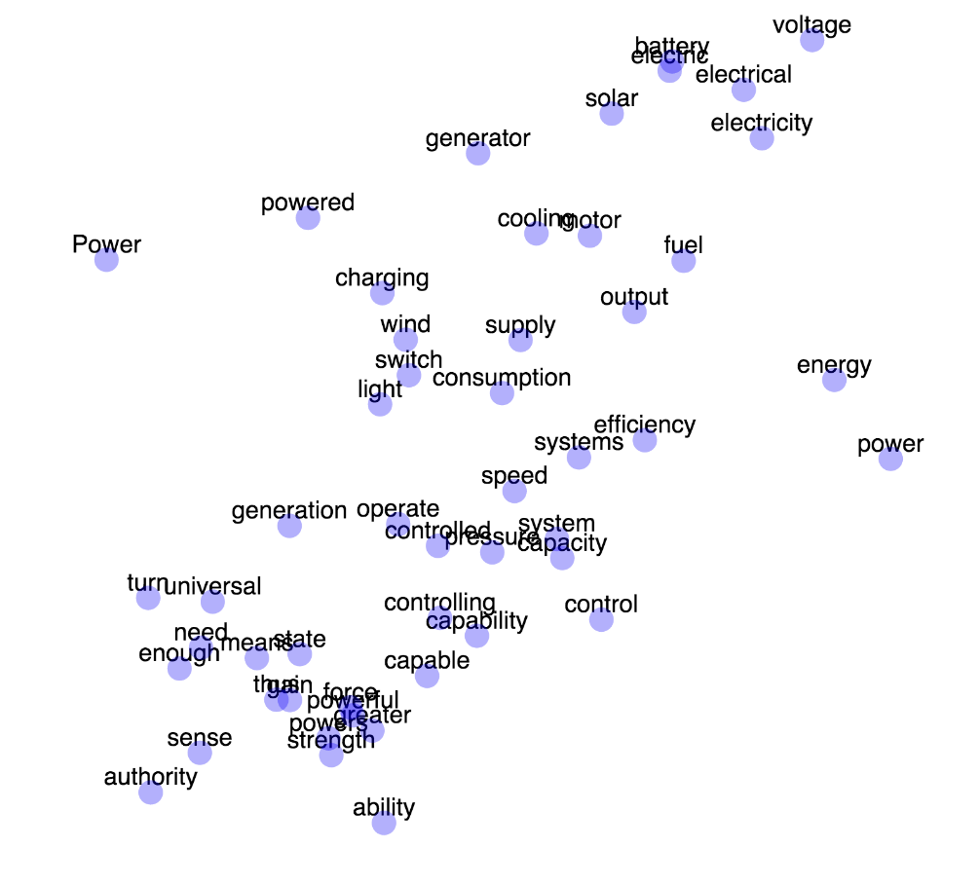
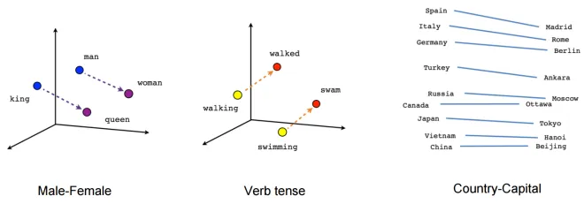
Gensim - Word2vec vectors visualization

Slide 14
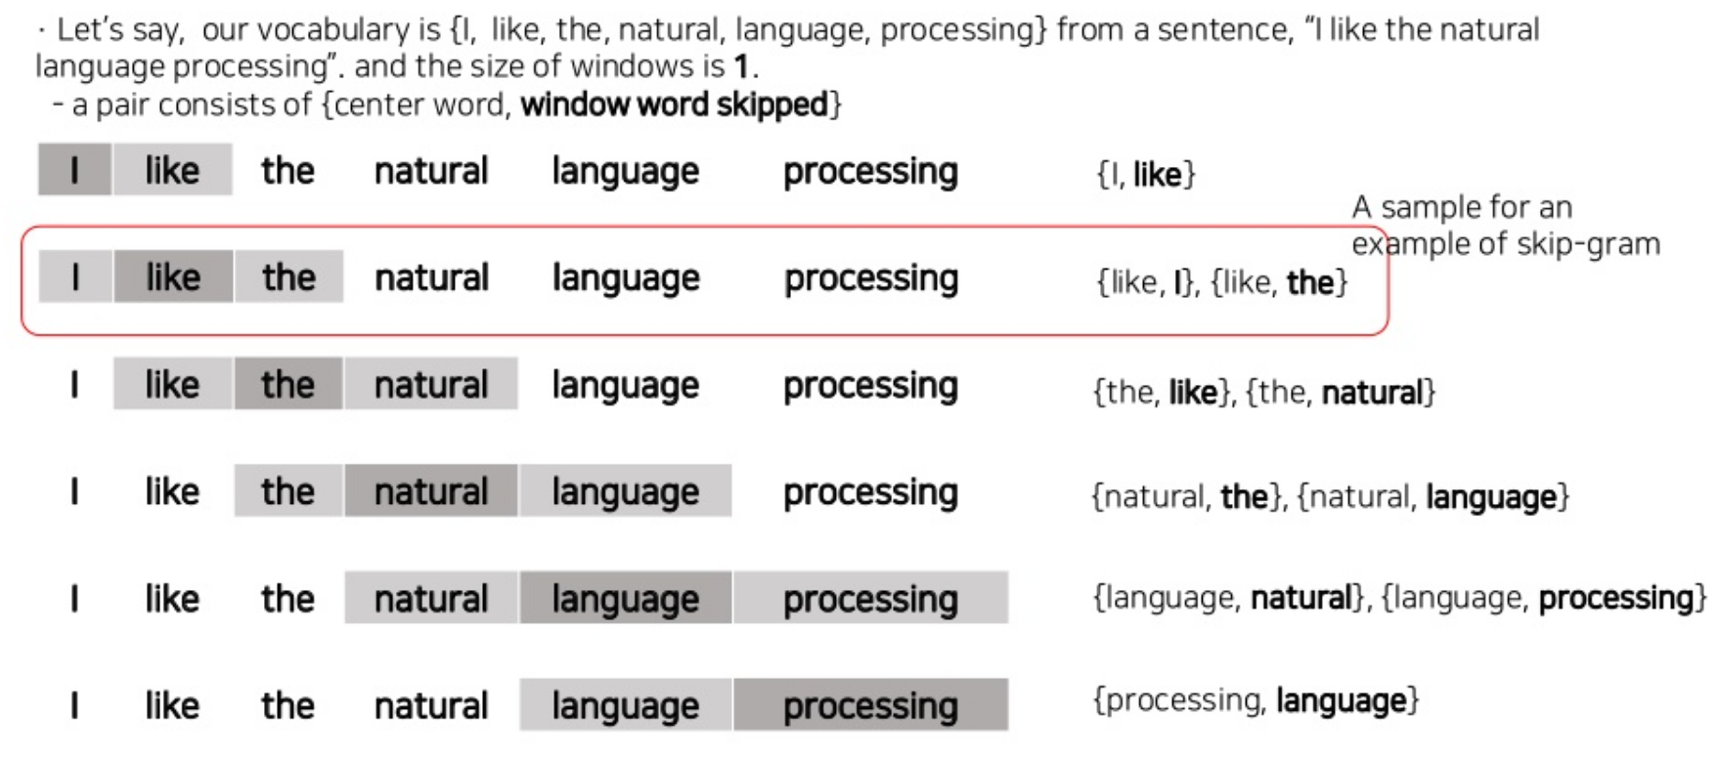

Slide 15
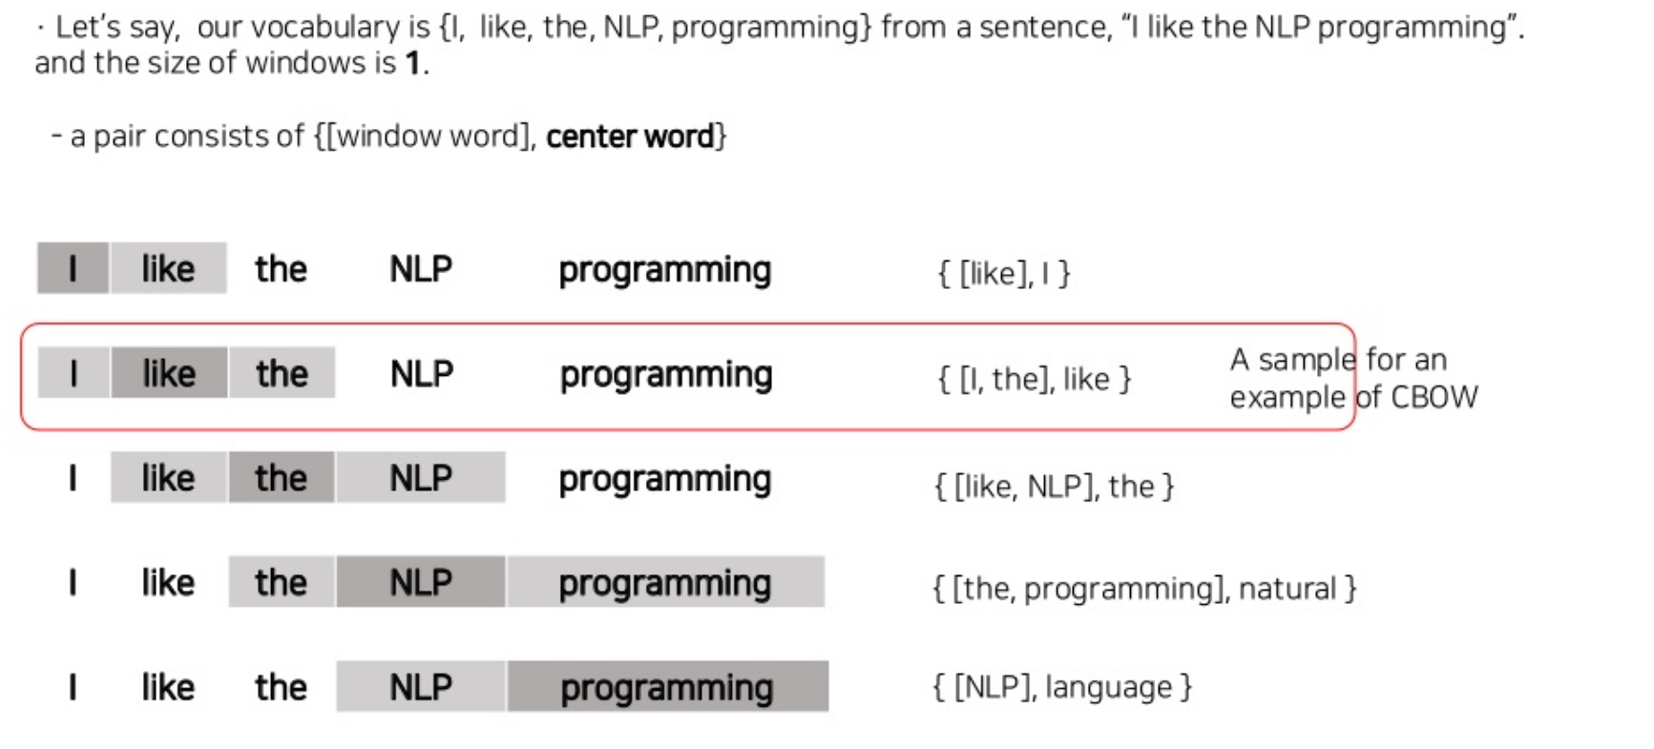

Slide 16
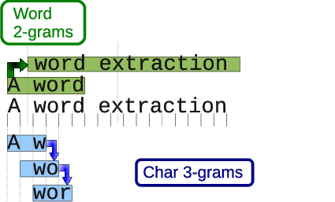
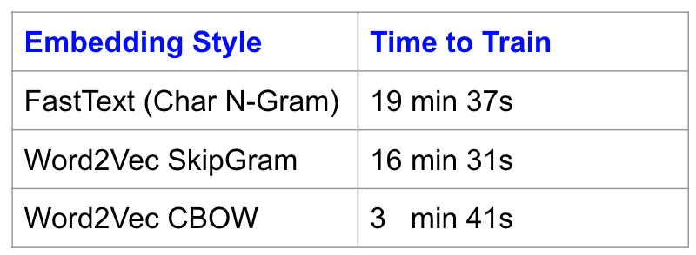
FastText

Slide 17
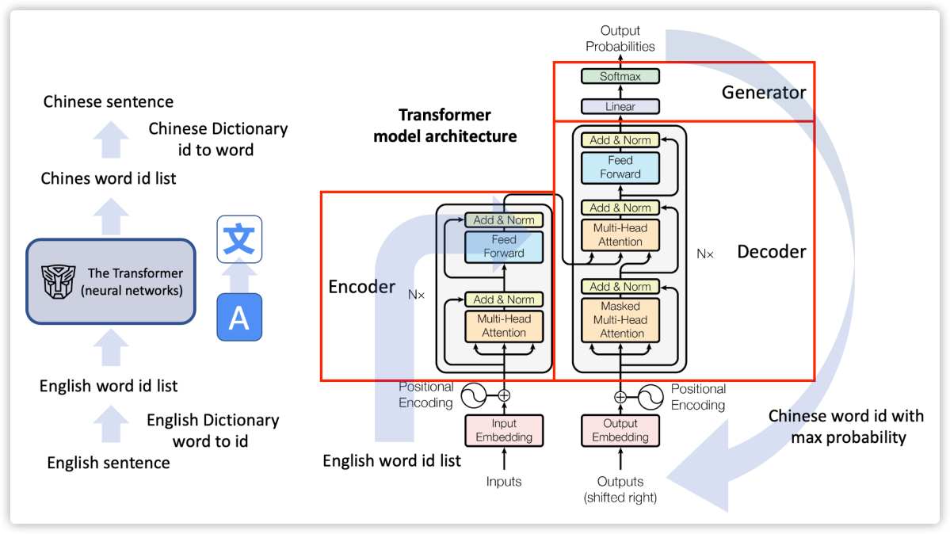
Transformers (t2t)

Slide 18
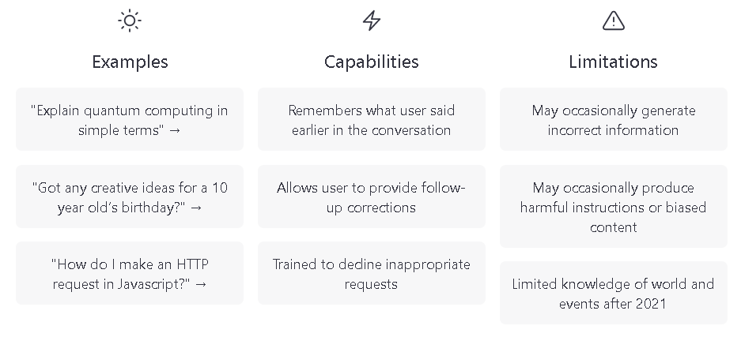
ChatGPT (GPT-3.5)

Slide 19
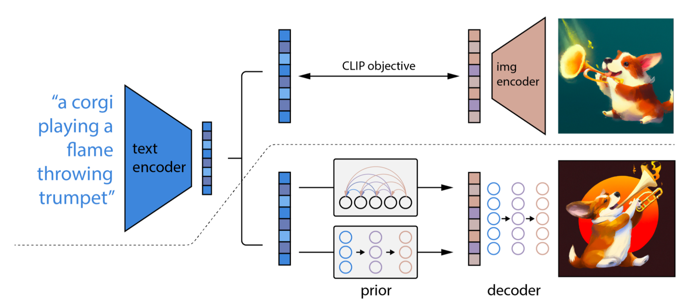
Diffusion models (t2i)

Slide 20
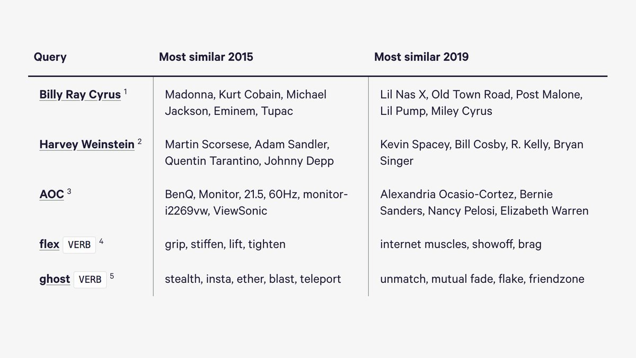
Sence2vec (https://github.com/explosion/sense2vec)

Slide 21
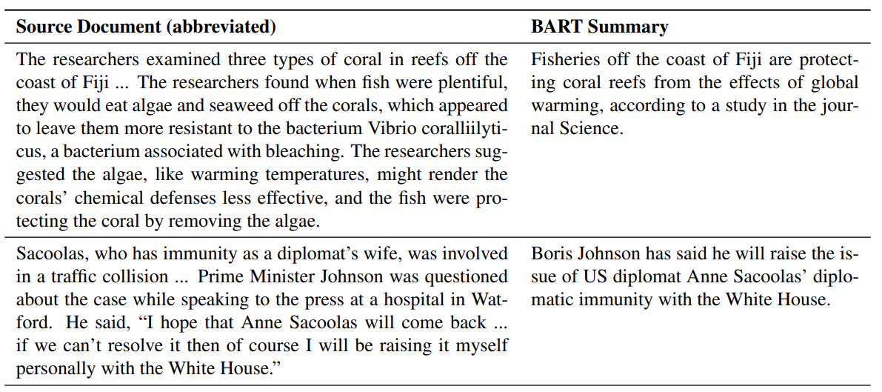
Text summarization (https://arxiv.org/pdf/1910.13461.pdf)

Slide 22
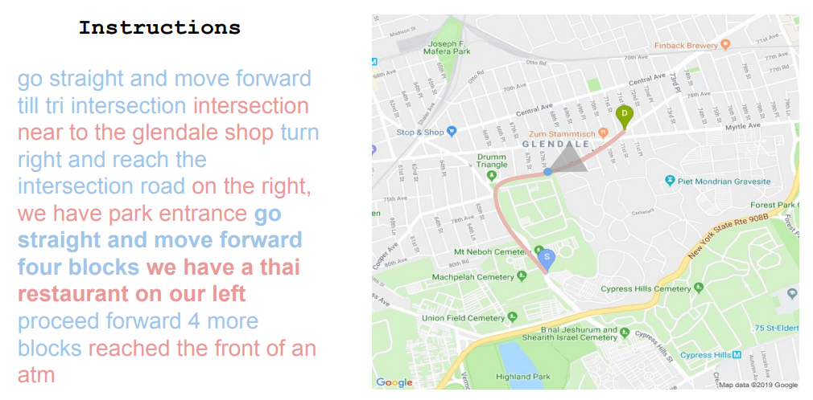
Talk2Nav: Long-Range Vision-and-Language Navigation in Cities (https://arxiv.org/pdf/1910.02029.pdf)

Slide 23
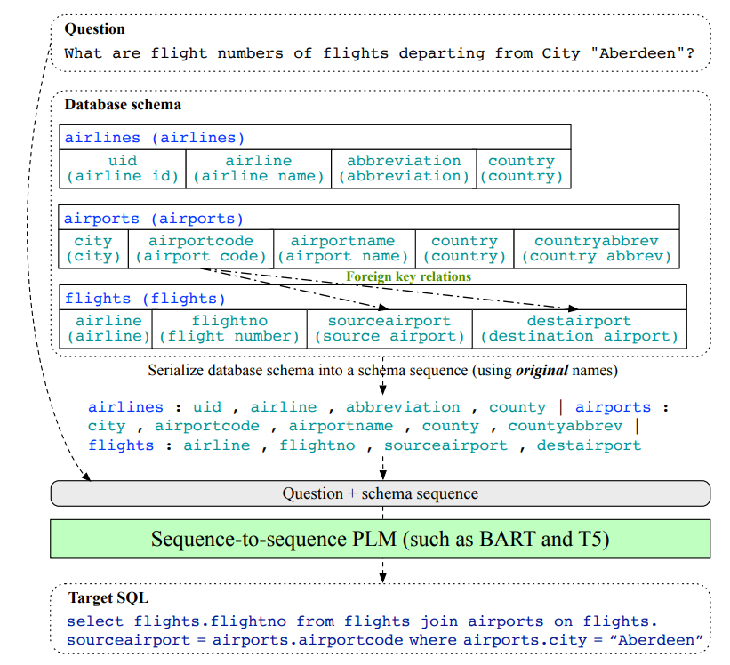
Text2SQL

Slide 24
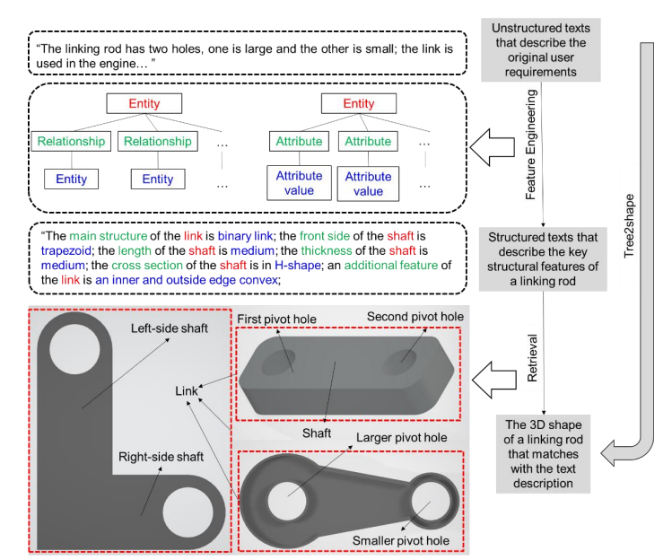
Text2Shape

Slide 25


Slide 26
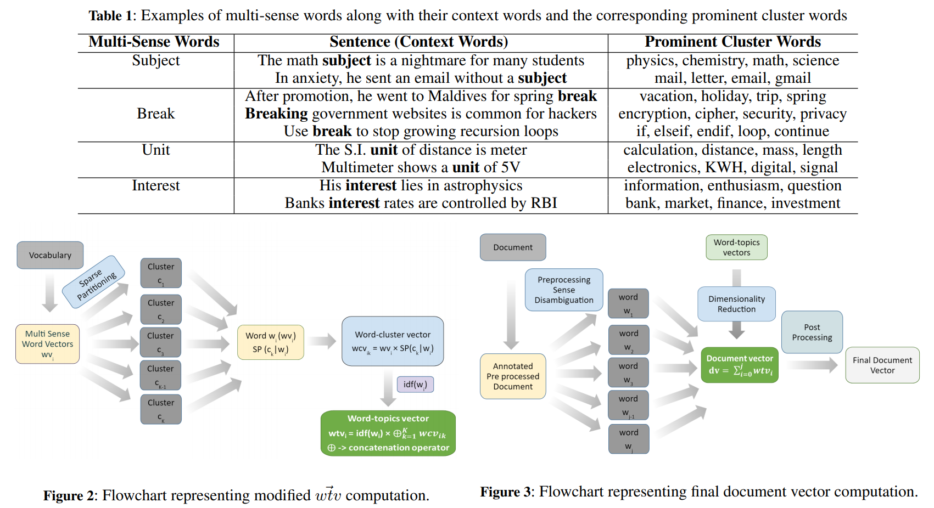
Improving Document Classification with Multi-Sense Embeddings (https://arxiv.org/pdf/1911.07918.pdf)

Slide 27
Hunting for Troll Comments in News Community Forums (https://arxiv.org/pdf/1911.08113.pdf)
Deep and dense sarcasm detection (https://arxiv.org/pdf/1911.07474.pdf)
Automatic Text-based Personality Recognition on Monologues and Multiparty Dialogues Using Attentive Networks and Contextual Embeddings (https://arxiv.org/pdf/1911.09304.pdf)
Log Message Anomaly Detection and Classification Using Auto-B/LSTM and Auto-GRU (https://arxiv.org/pdf/1911.08744.pdf)

Slide 28
